Slide 1
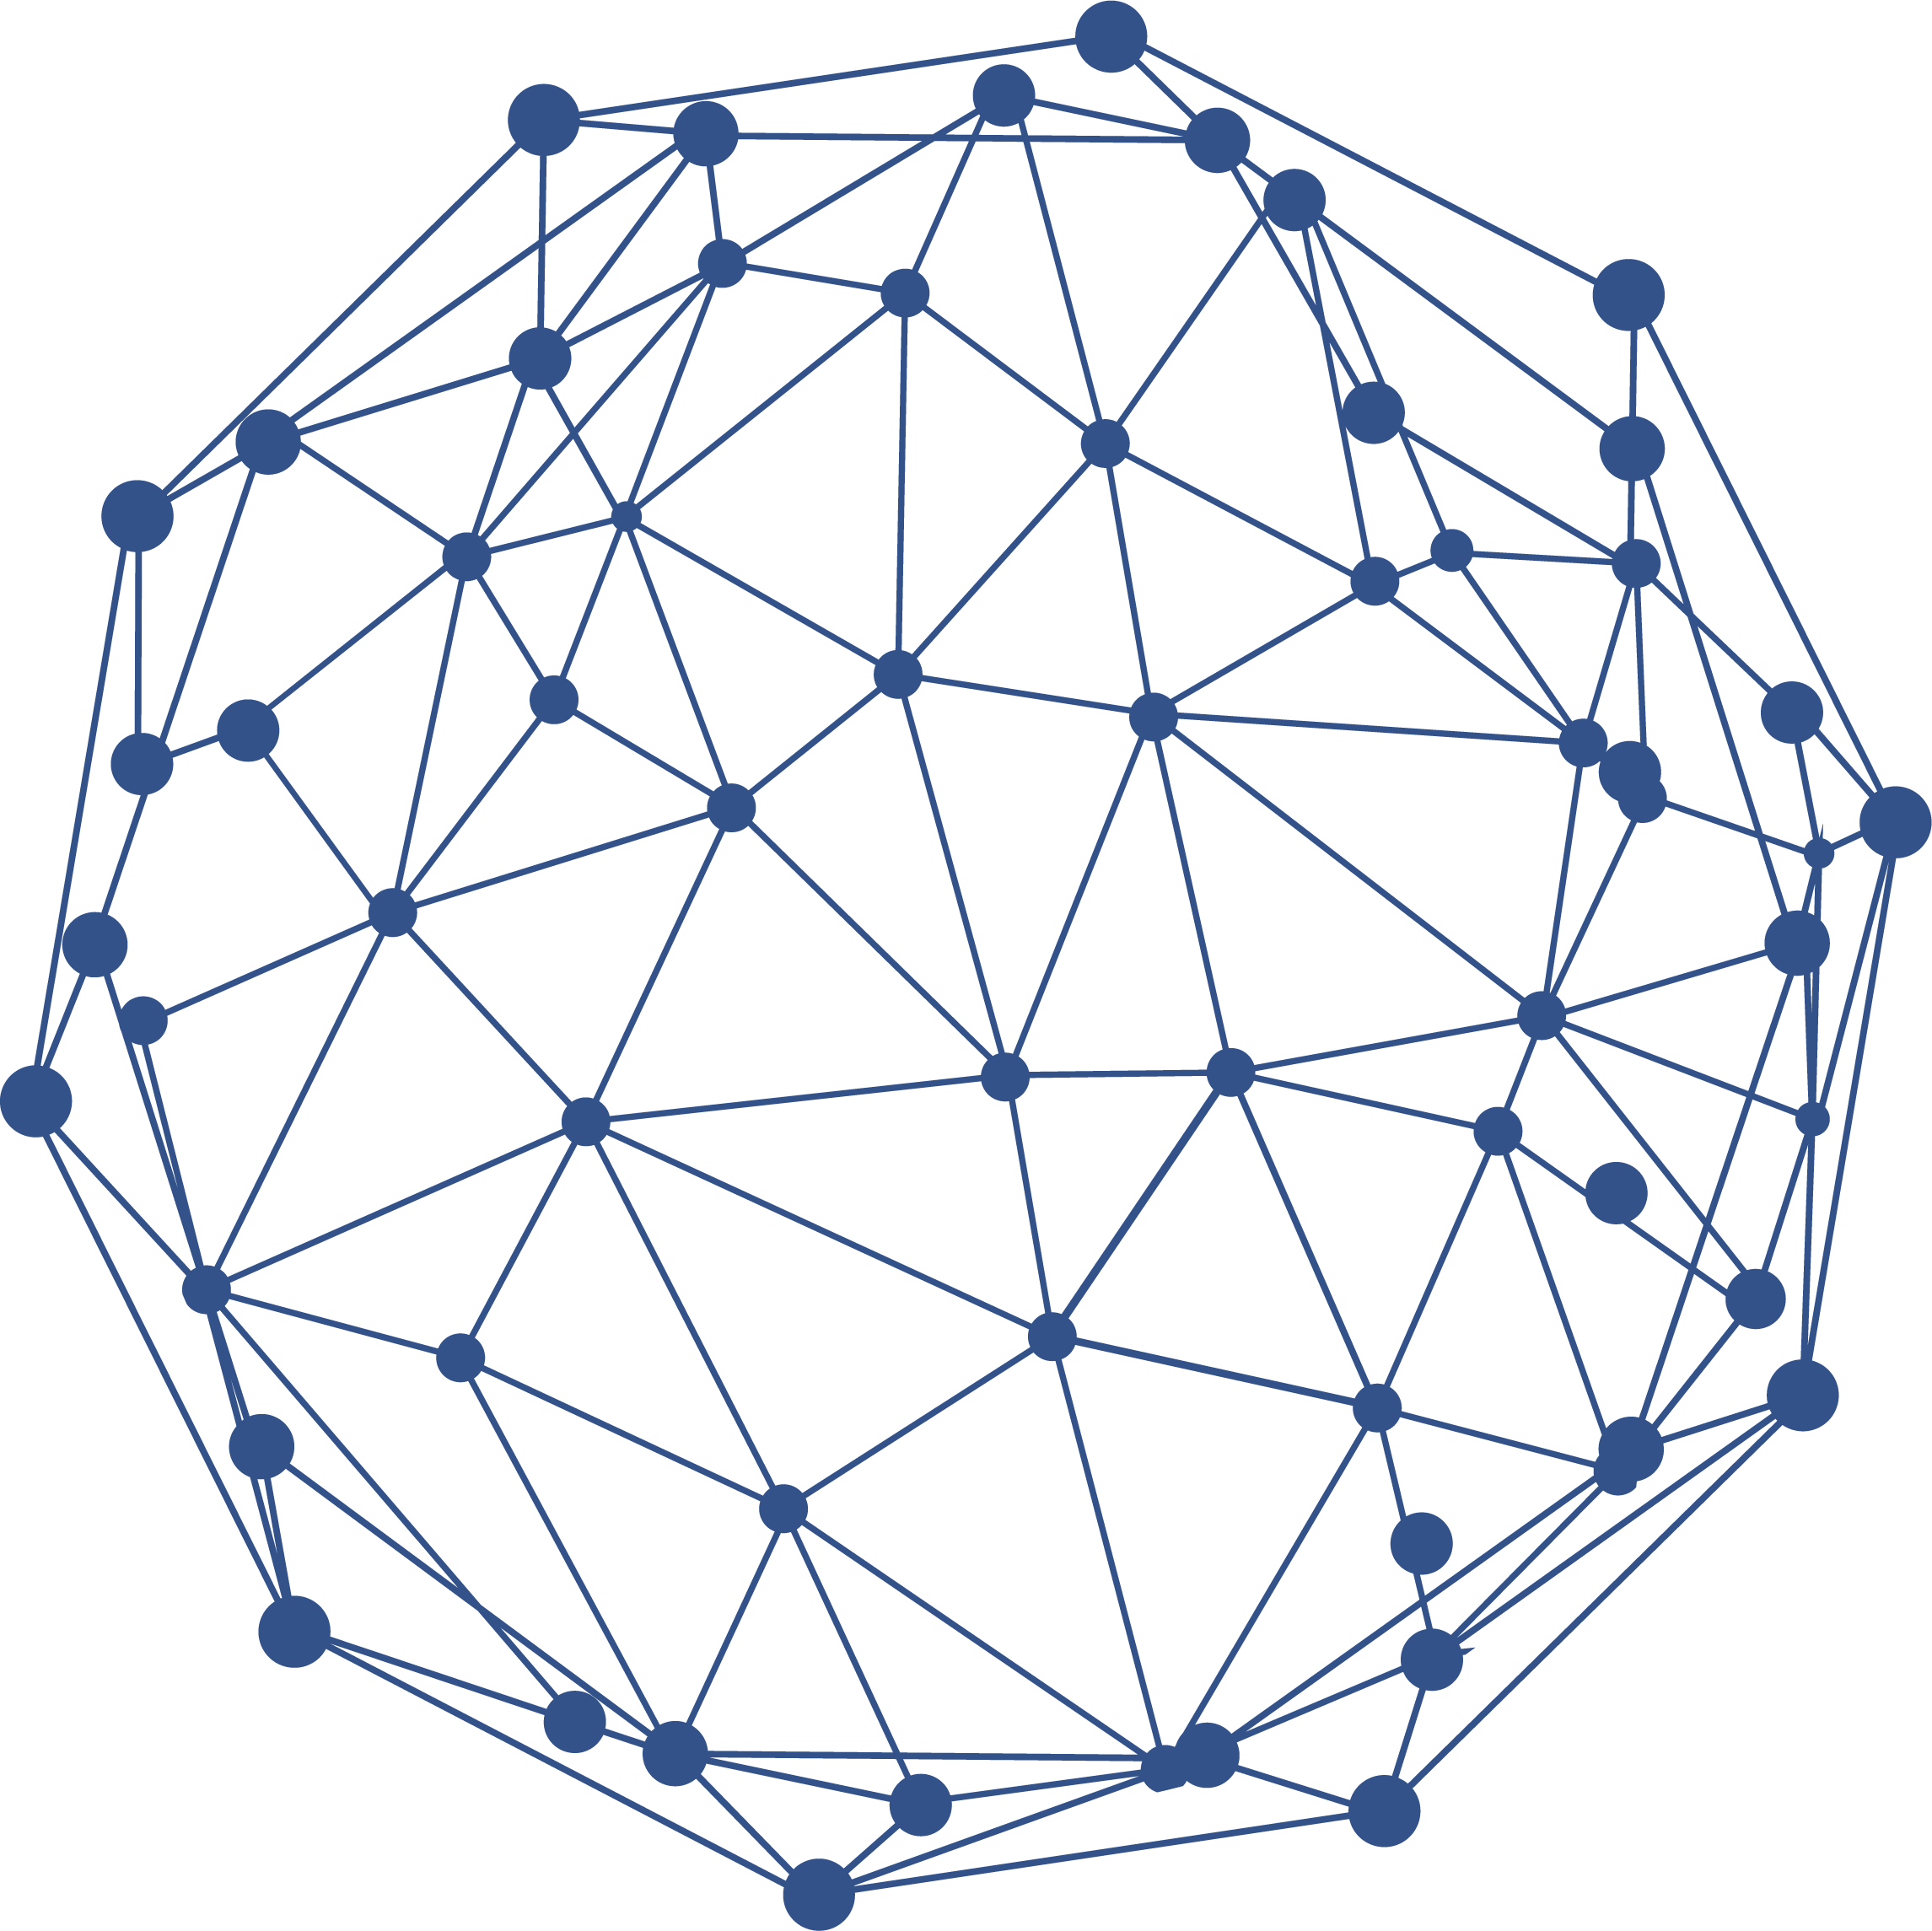


FRAMEWORK TO SELECT AN IMPROVED RADIOGRAPHIC IMAGE USING SMPSO
NATIONAL UNIVERSITY OF ASUNCIÓN
PARAGUAY
POLYTECHNICAL FACULTY
GECCO '20, July 8 - 12, 2020, Cancun, Mexico
ALAN M. RUIZ DÍAZ NODARI | alan0dari96@fpuna.edu.py
LUHANA A. GONZÁLEZ ZARZA | lulu08zarza@fpuna.edu.py
POSTER ID: pos244
DOI: https://doi.org/10.1145/3377929.3390064

Slide 2


INTRODUCTION

Slide 3

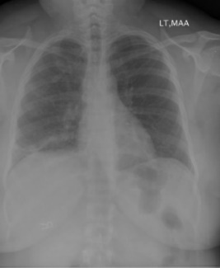

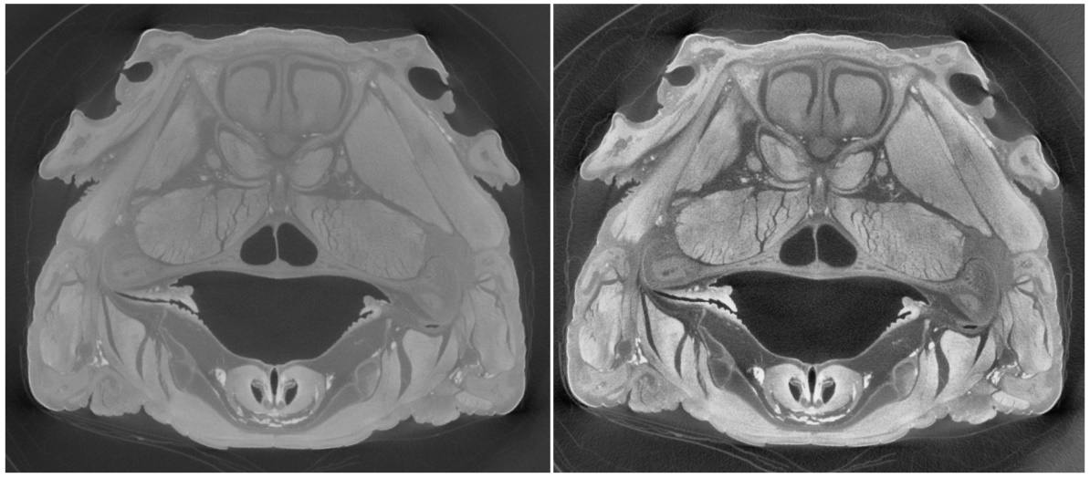
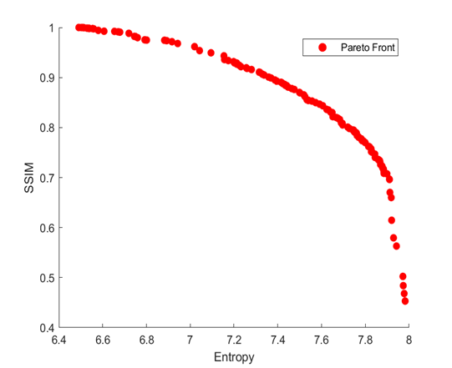


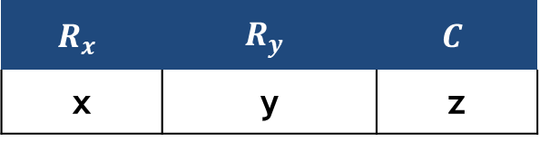
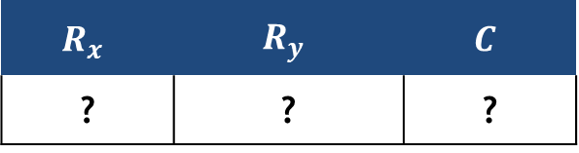
Issues
Radiographic images suffer from contrast problems. They are improved with contrast enhancement techniques.
In a contrast enhancement scenario, there are several attributes that are affected, we take into account two of them: entropy and structural similarity.
In the area of medical imaging, the CLAHE method has been shown better results in the contrast enhancement.
There are no fixed CLAHE input parameters for x-ray images.
Using the SMPSO evolutionary algorithm, the CLAHE input parameters can be tuned in order to find all of its fitting combination values, therefore generating a Pareto Set.
All the solutions of the Pareto Set are optimal, but only one must be selected in order to satisfy the requirements of the expert.
Low contrast
Dark
Noisy
Entropy
SSIM
CLAHE
$$R_{x}$$ | $$R_{y}$$ | $$C$$
? | ? | ?
✓
$$R_{x}$$ | $$R_{y}$$ | $$C$$
x | y | z
SMPSO

Slide 4


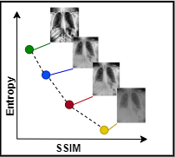


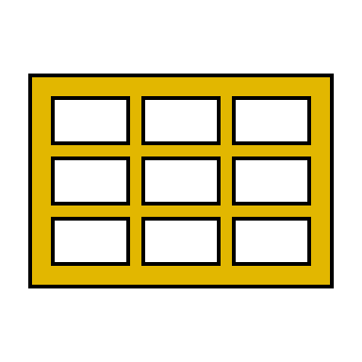
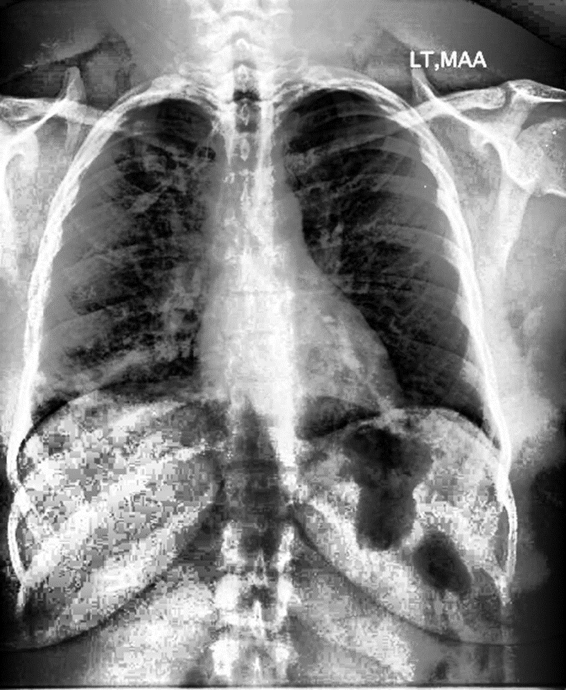
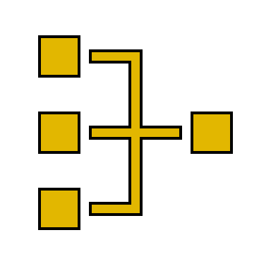


Radiografía a mejorar (imagen de entrada)
Se aplica SMPSO-CLAHE mejorado (proceso evolutivo de optimización mutiobjetivo)
Genera un Frente Pareto (soluciones candidatas)
Se aplica método de decisión multicriterio a posteriori para seleccionar una imagen mejorada
Profesional médico en radiografías utiliza la imagen seleccionada
Mapea el Frente Pareto a una matriz de decisión

Slide 5
Se aplica SMPSO-CLAHE (proceso evolutivo de optimización mutiobjetivo)
Radiografía a mejorar (imagen de entrada)
Profesional médico en radiografías elige una radiografía mejorada
Genera un Frente Pareto (soluciones candidatas)

Slide 6
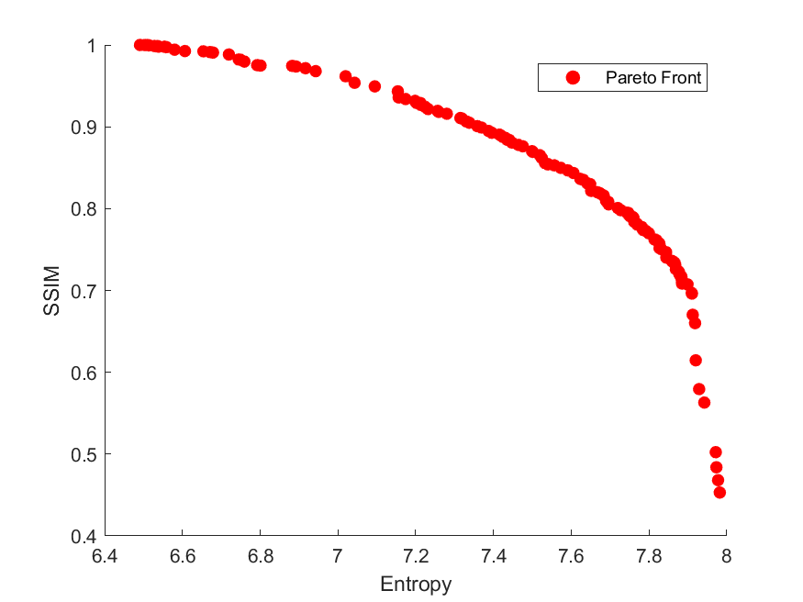

Proposal
Extremes of the Pareto Set do not provide useful information.
The use of multi-objective decision methods is necessary.
Three state-of-the-art techniques were analyzed, used and compared to build a better tool in the decision making process:
SMARTER.
TOPSIS.
Bellman-Zadeh Fuzzy method.
B
A
C

Slide 7
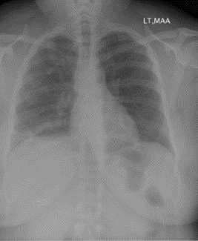
Imagen de entrada
MOPSO-CLAHE
(Proceso evolutivo)
FRENTE PARETO
(Soluciones óptimas)

Slide 8
EXPERIMENTATION

Slide 9
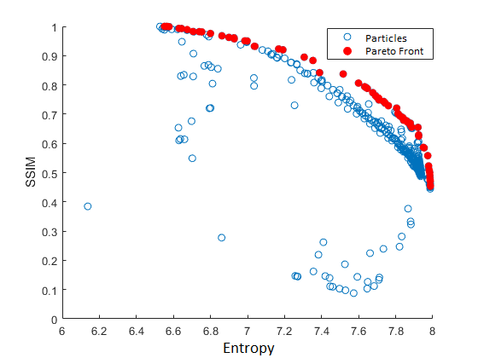

Parameters
The SMPSO-CLAHE was executed 100 times for each image and in each execution 100 iterations were performed, that is, 10.000 solution-particles generated.
Approximately 500 particles (5%) are non dominated solutions (Pareto Set).
The decision methods use weights ($w$) that determine the importance of one attribute towards another. In this case more importance is given to entropy instead of SSIM.
Three instances of them are chosen:
$w_{1}$ = entropy-based weight algorithm.
$w_{2}$ = Roberts & Goodwing constant values (0.6932 and 0.3068).
$w_{3}$ = same importance for both entropy and SSIM (0.5).

Slide 10
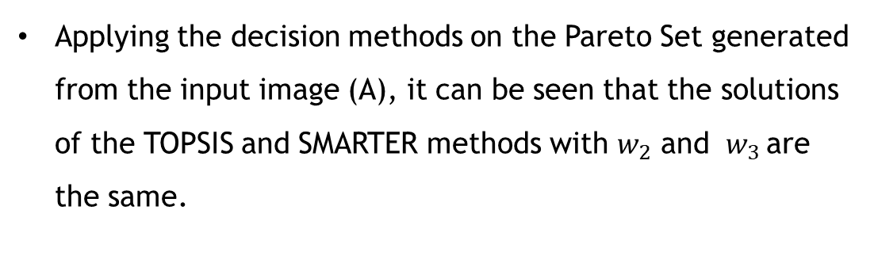
Results
CLAHE
parameters
Objective
Functions
Methods
Weight
Entropy
SSIM
Rx
Ry
C
w
2
25
0,0000
6,5669
0,9998
1
SMARTER
w
2
2
0,0072
7,3532
0,8835
2
w
2
2
0,0095
7,5167
0,8373
3
w
2
9
0,0000
6,5515
1,0000
1
FUZZY
w
104
2
0,2966
7,9873
0,4533
2
w
104
2
0,2966
7,9873
0,4533
3
w
2
206
0,0000
6,5763
0,9991
1
TOPSIS
w
2
2
0,0072
7,3532
0,8835
2
w
2
2
0,0095
7,5167
0,8373
3
Input image A
Applying the decision methods on the Pareto Set generated from the input image (A), it can be seen that the solutions of the TOPSIS and SMARTER methods with $w_{2}$ and ${ w}_{3}$are the same.

Slide 11

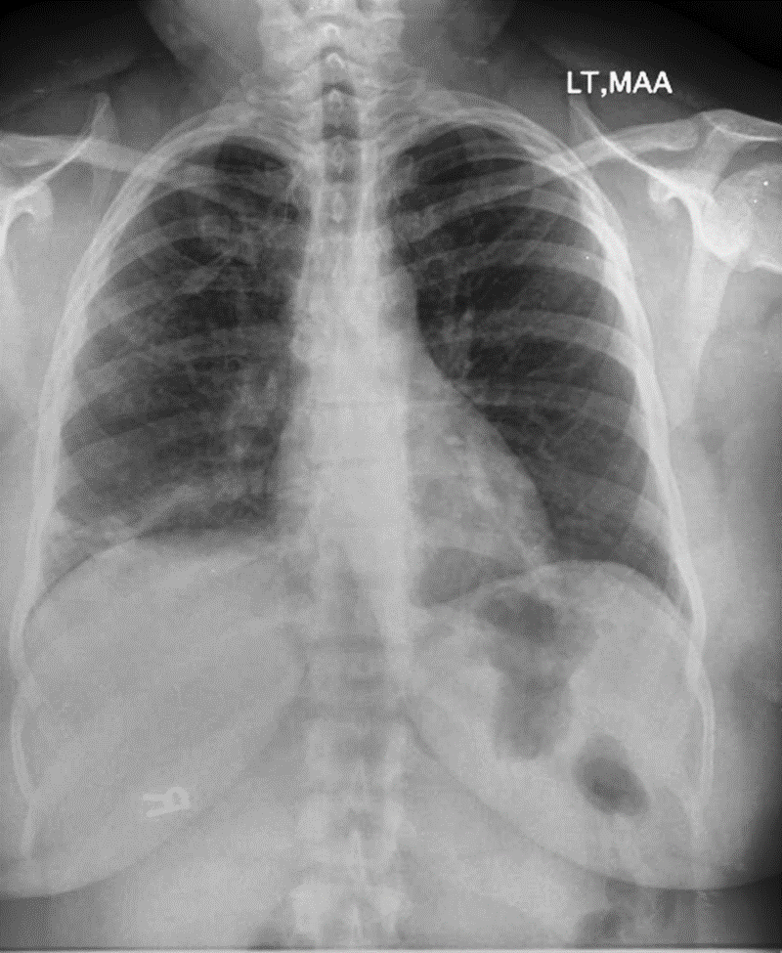
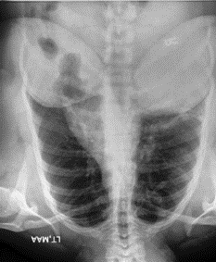
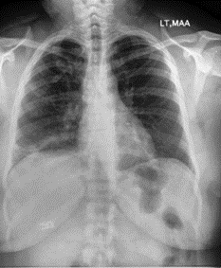
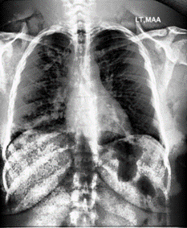
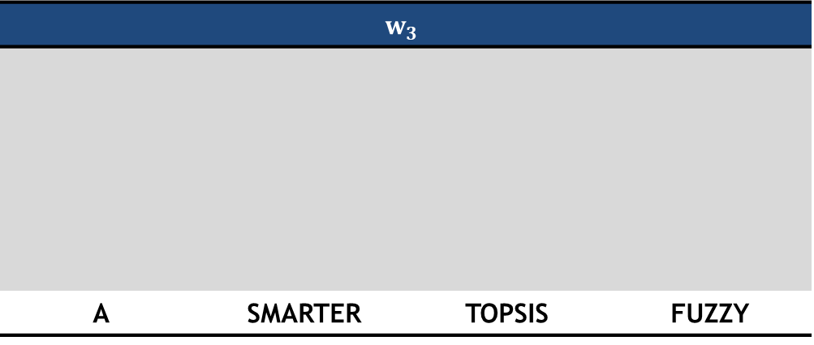
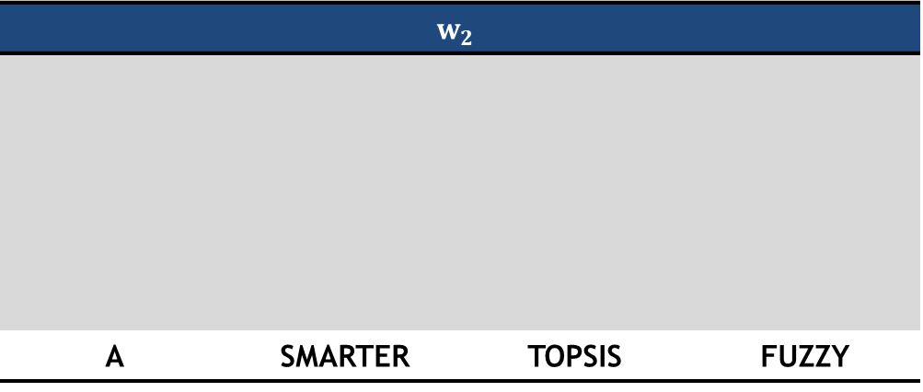
Results
$$w_{2}$$
A | SMARTER | TOPSIS | FUZZY
$$w_{3}$$
A | SMARTER | TOPSIS | FUZZY

Slide 12
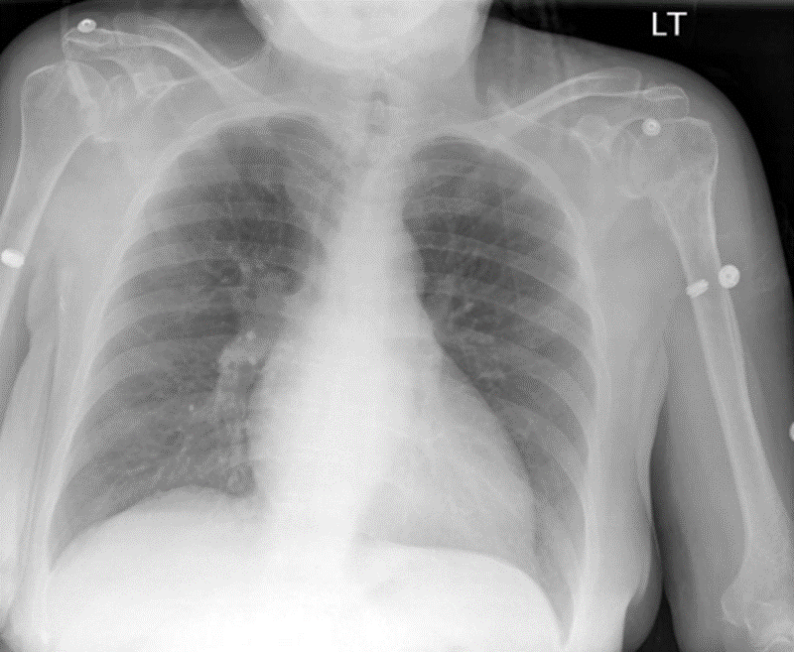

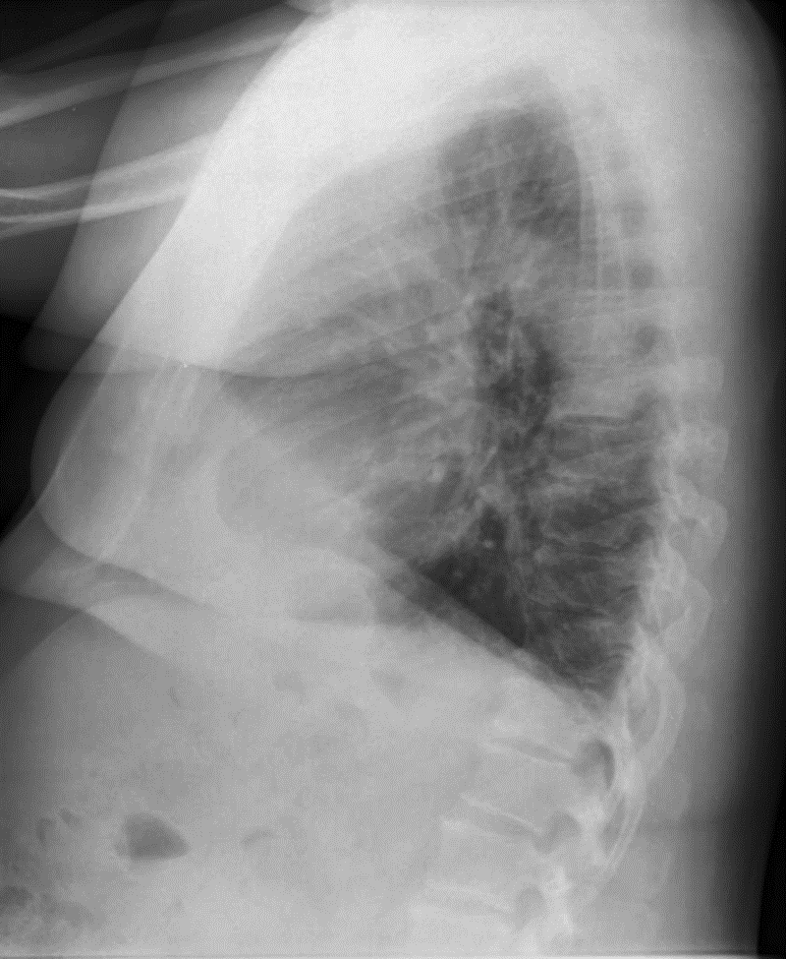
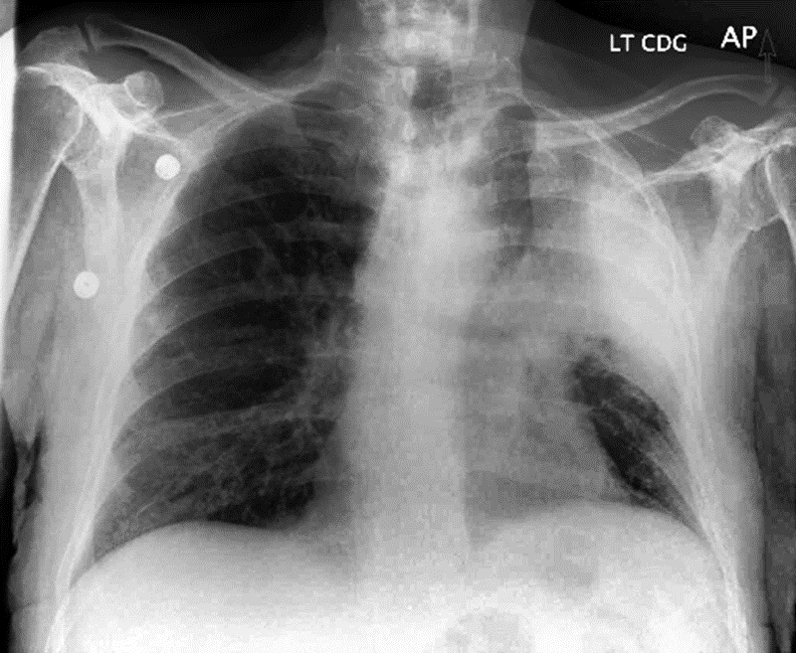
Results
The same pattern was found on the other x-ray images experimented.
In the tests carried out the Fuzzy method chooses solutions that are close to the extremes (not useful).
A local medical imaging expert was surveyed with a set of x-ray images selected with the three decision methods.
His particular selection agreed with the SMARTER and TOPSIS methods in equal percentage.
SMARTER
TOPSIS
SMARTER
TOPSIS
SMARTER (50%)
TOPSIS (50%)
SMARTER
TOPSIS

Slide 13
CONCLUSIONS

Slide 14
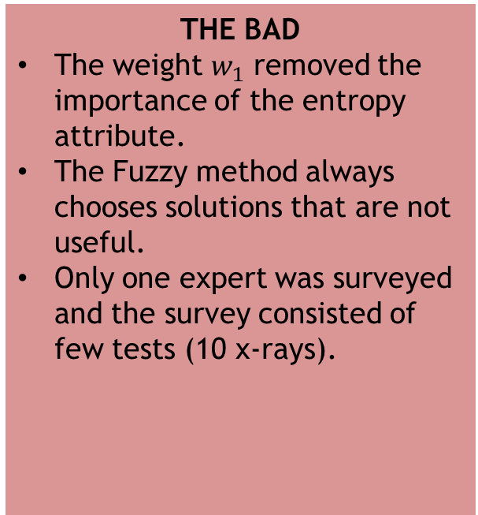
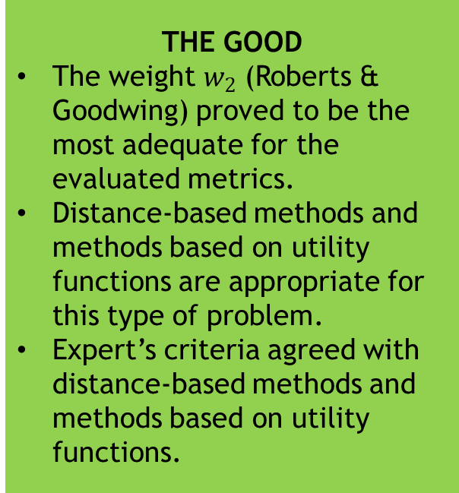
Findings
THE GOOD
The weight $w_{2}$ (Roberts & Goodwing) proved to be the most adequate for the evaluated metrics.
Distance-based methods and methods based on utility functions are appropriate for this type of problem.
Expert’s criteria agreed with distance-based methods and methods based on utility functions.
THE BAD
The weight $w_{1}$ removed the importance of the entropy attribute.
The Fuzzy method always chooses solutions that are not useful.
Only one expert was surveyed and the survey consisted of few tests (10 x-rays).

Slide 15
Future work
It is necessary to make a mapping of all the a posteriori decision methods and face each one of them to have a greater variation of results.
We recommend trying other combinations of attributes for medical imaging in general (eg PSNR and spatial frequency).
To reach an agreement about which type of method is the most suitable for x-ray images, we understand that more experts should be surveyed with more tests taking into account the previous points.

Slide 16
THANK YOU

